Slide 1
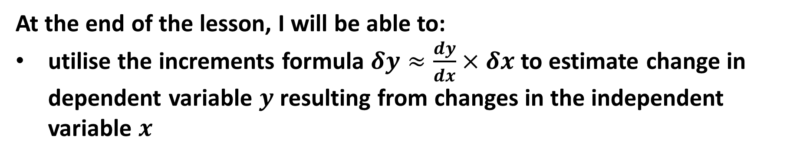

Learning Objective
I will be able to estimate change in dependent variable $y$ resulting from changes in the independent variable $x$
Success Criteria
At the end of the lesson, I will be able to:
utilise the increments formula $δy≈\frac{dy}{dx}×δx$ to estimate change in dependent variable $y$ resulting from changes in the independent variable $x$

Slide 2
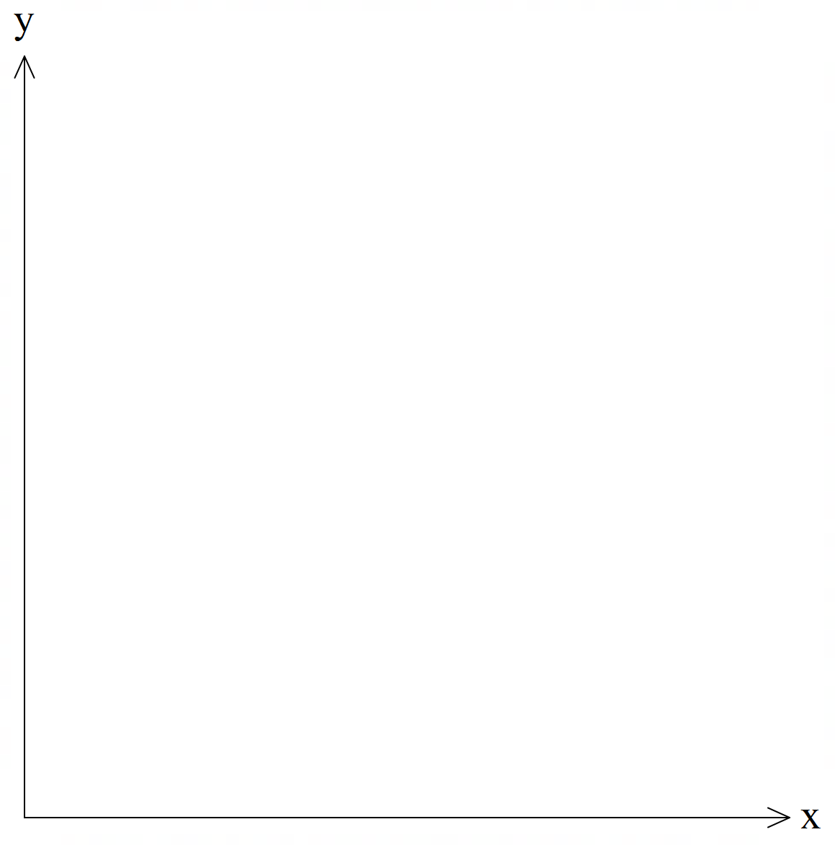
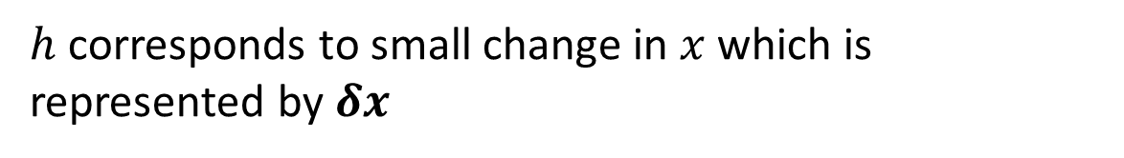

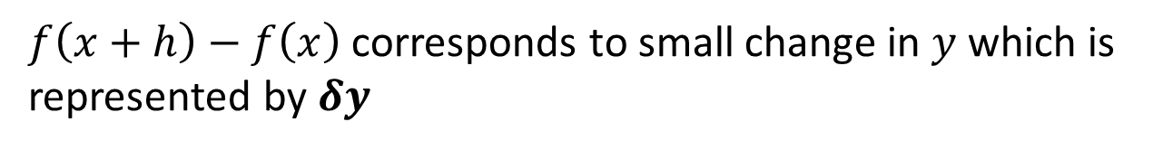


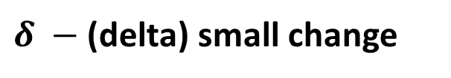


First Derivative
Small Increments Formula
B
Definition of a derivative function $f(x)$ is given by
$$f^{′}\left(x\right)= \lim_{h→0}{\frac{f\left(x+h\right)−f(x)}{h}}$$
$$(x+h,f(x+h)$$
A
$$(x,f\left(x\right))$$
For h that is small,
$$f^{′}\left(x\right)≈ {\frac{f\left(x+h\right)−f(x)}{h}}$$
Rewriting in Leibniz notation
$f\left(x+h\right)−f\left(x\right)$ corresponds to small change in $y$ which is represented by $δy$
$δ −$ (delta) small change
$h$ corresponds to small change in $x$ which is represented by $δx$
$$∴\frac{dy}{dx}≈\frac{δy}{δx}$$

Slide 3







Guided Practice
Let $f\left(x\right)=x^{4}−x^{3}$. Determine the approximate change in $f\left(x\right)$ as $x$ changes from $2$ to $2+h$ where $h$ is small.
Trying to find small change in y, $δy$
Let $y=f\left(x\right)=x^{4}−x^{3}$
$$\frac{dy}{dx}=4x^{3}−3x^{2}$$
Since $h$ is small, $\frac{δy}{δx}≈\frac{dy}{dx}$
Rearranging, $δy≈\frac{dy}{dx}×δx$
Subs $x=2, δx=h,$
$$δy≈\left[4{\left(2\right)}^{3}−3{\left(2\right)}^{2}\right]×h$$
$$δy≈20h$$

Slide 4

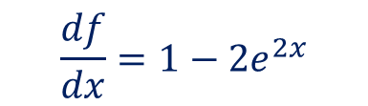
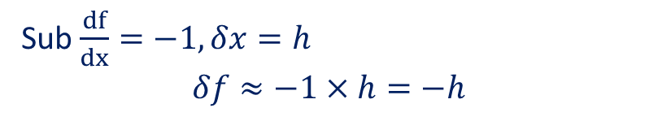

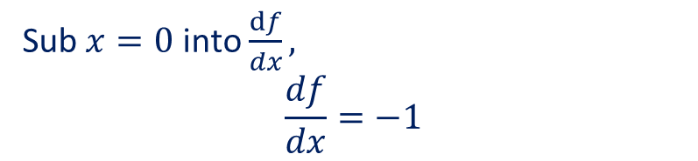

Guided Practice
Given that $f\left(x\right)=x−e^{2x}$, find the approximate change in $f(x)$ as $x$ changes from $0$ to $h$ where $h$ is small.
Sub $x=0$ into $f(x),$
$$f\left(0\right)=−1$$
Sub $\frac{df}{dx}=−1, δx=h$
$$δf≈−1×h=−h$$
$$\frac{df}{dx}=1−2e^{2x}$$
$∴$ approx. change in f(x) is $−h$
Sub $x=0$ into $\frac{df}{dx},$
$$\frac{df}{dx}=−1$$
Recall for small increment change,
$$\frac{δf}{δx}≈\frac{df}{dx}$$

Slide 5





Guided Practice
Find the approximate increase in the radius of a circular disc if its area increases from $100π$ cm² to $101π$ cm².
$$A=πr^{2}$$
$$r=\sqrt{\frac{A}{π}}={\left(\frac{1}{π}A \right)}^{0.5}$$
By the Chain Rule:
$$\frac{dr}{dA}=0.5×\frac{1}{π}{\left(\frac{1}{π}A \right)}^{−0.5}$$
$$δA=π$$
$$\frac{δr}{δA}≈\frac{dr}{dA}$$
$$δr≈\frac{dr}{dA}×δA$$
$$δr≈0.5×\frac{1}{π}{\left(\frac{1}{π}\text{(100}π) \right)}^{−0.5}×π$$
$$δr=\frac{1}{20}cm$$

Slide 6
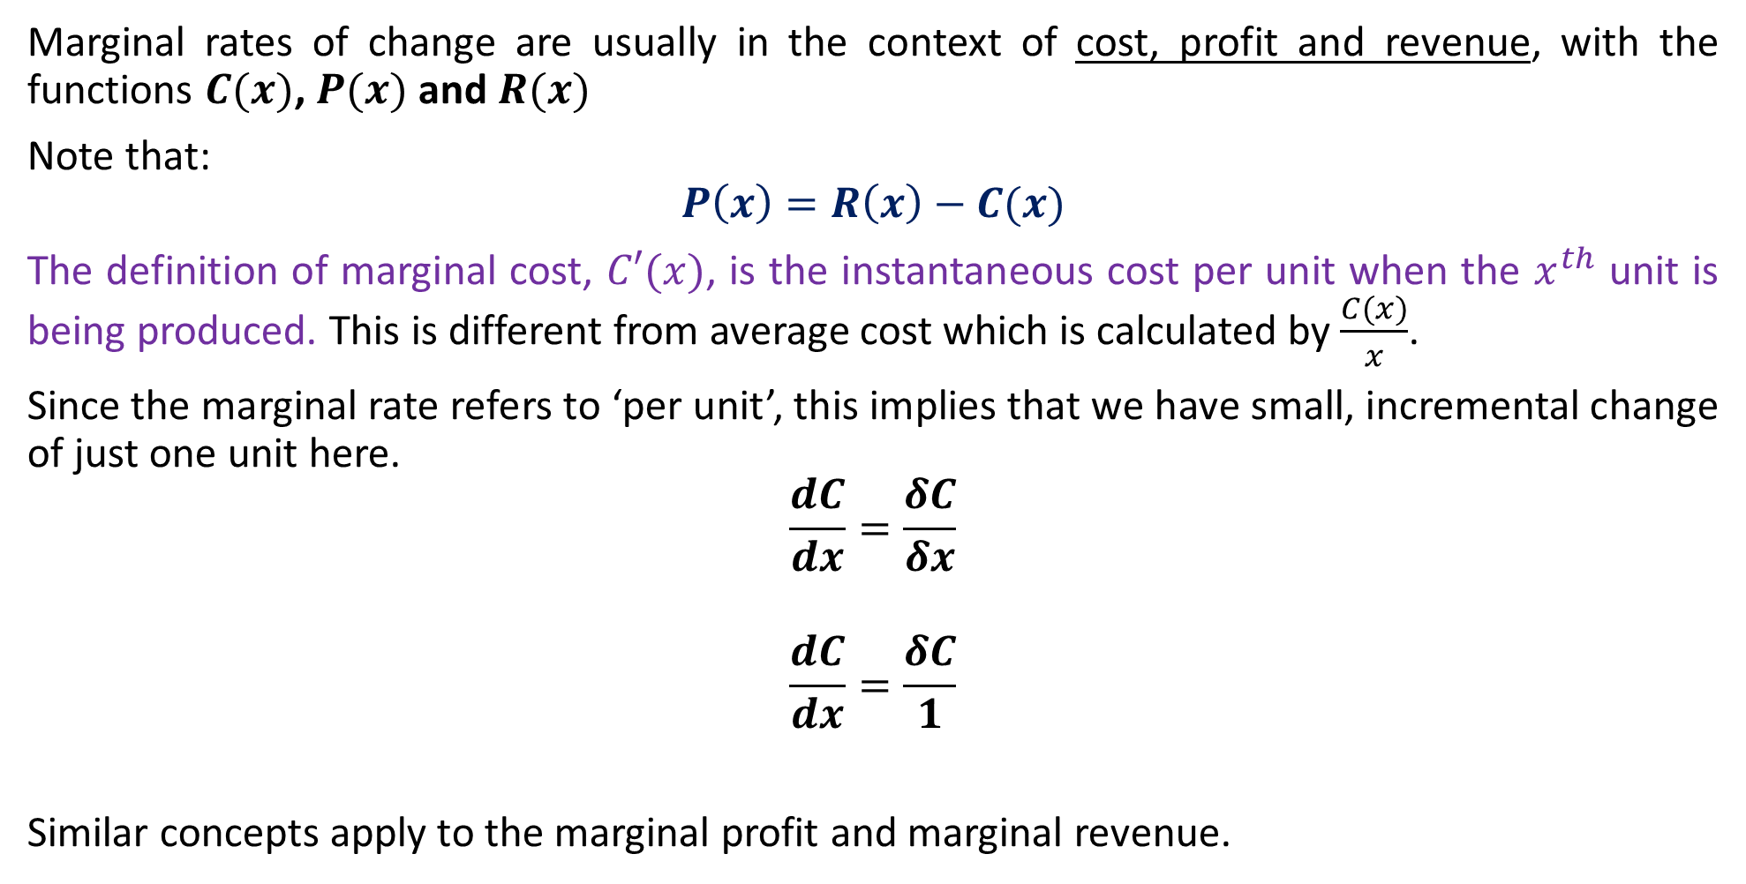
Marginal Rates of Change
Marginal rates of change are usually in the context of cost, profit and revenue, with the functions $C(x)$, $P(x)$ and $R(x)$
Note that:
$$P\left(x\right)=R\left(x\right)−C(x)$$
The definition of marginal cost, $C′(x)$, is the instantaneous cost per unit when the $x^{th}$ unit is being produced. This is different from average cost which is calculated by $\frac{C(x)}{x}$.
Since the marginal rate refers to ‘per unit’, this implies that we have small, incremental change of just one unit here.
$$\frac{dC}{dx}=\frac{δC}{δx}$$
$$\frac{dC}{dx}=\frac{δC}{1}$$
Similar concepts apply to the marginal profit and marginal revenue.

Slide 7
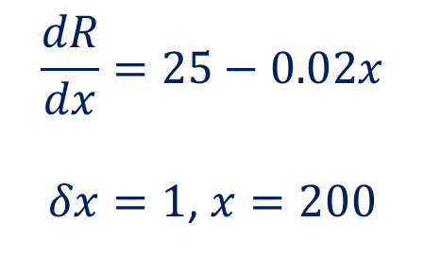




Guided Practice
The total revenue, $R, from the sale of $x$ items is given by
$$R=25x−0.01x^{2}$$
Use differentiation to determine the approximate revenue increase from the sale of one more item at the stage in the production when $x=200$
$$\frac{dR}{dx}=25−0.02x$$
$δx=1$, $x=200$
$$\frac{δy}{δx}≈ \frac{dy}{dx}$$
$$\frac{δy}{1}≈ 25−0.02(200)$$
$$δy=21$$
$∴$The change in revenue is approximately $21

Slide 8

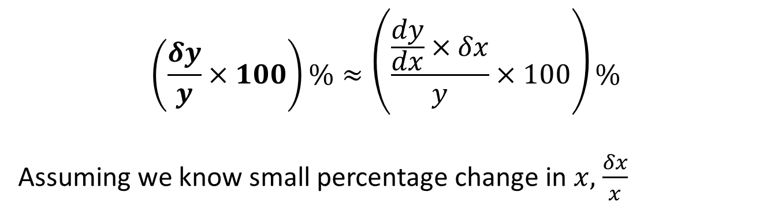
Small Increments Percentage change
Small Increment of $y$is given by:
$$δy≈\frac{dy}{dx}×δx$$
To find any percentage change, we divide change by original and multiply by 100
$∴$ small percentage change in $y$ is given by
$$\left(\frac{δy}{y}×100\right)\%≈\left(\frac{\frac{dy}{dx}×δx}{y}×100\right)\%$$
Assuming we know small percentage change in $x,$ $\frac{δx}{x}$

Slide 9


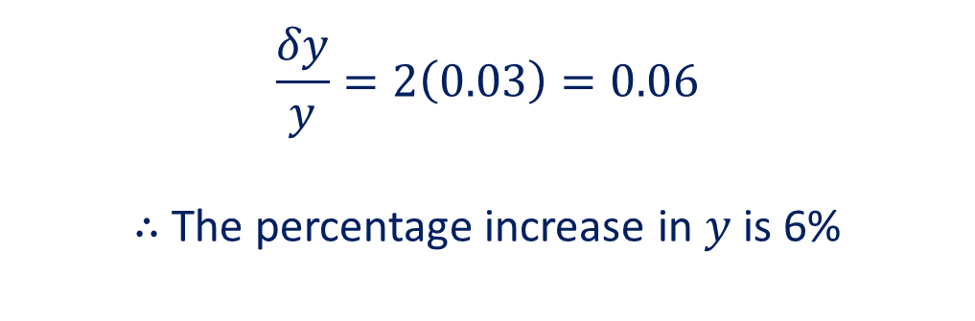
Guided Practice
If $y=3x^{2}$, determine the percentage increase in $y$ when $x$ is increased by $3\%$.
Note that $\frac{δx}{x}=0.03$ (converted to an increment)
$$\frac{dy}{dx}=6x$$
$$δy=\frac{dy}{dx}×δx=6x×δx$$
$$\frac{δy}{y}=\frac{6x×δx}{y}$$
$$\frac{δy}{y}=\frac{6x×δx}{3x^{2}}$$
$$\frac{δy}{y}=2\frac{δx }{x}$$
$$\frac{δy}{y}=2\left(0.03\right)=0.06$$
$∴$ The percentage increase in $y$ is 6%

Slide 10


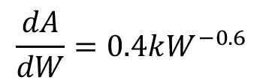
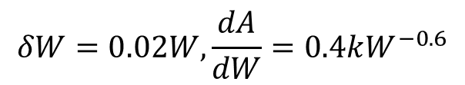
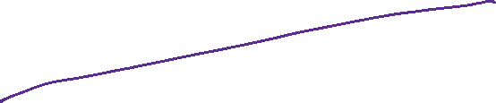


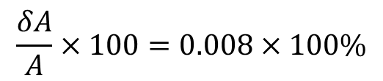
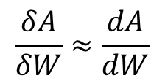
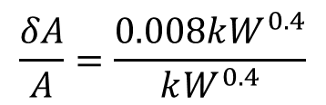


Guided Practice
Let us suppose that a person’s body surface area, $A$, is related to the person’s weight according to the rule $A=kW^{0.4}$ for some constant $k$. Use differentiation to find the approximate percentage gain in A when W increases by $2\%$.
$$\frac{dA}{dW}=0.4kW^{−0.6}$$
$$\frac{δA}{A}=\frac{0.008kW^{0.4}}{kW^{0.4}}$$
Note $\frac{δW}{W}=0.02$
$$\frac{δA}{A}×100=0.008×100\%$$
$$\frac{δA}{δW}≈\frac{dA}{dW}$$
$$=0.8\%$$
$$δA≈\frac{dA}{dW}×δW$$
The approximate percentage gain is $0.8\%$
$$δW=0.02W, \frac{dA}{dW}=0.4kW^{−0.6}$$
$$δA=0.4kW^{−0.6}×0.02W$$
$$δA=0.008kW^{0.4}$$

Slide 11
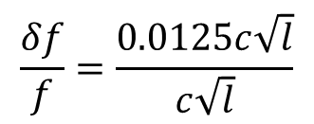

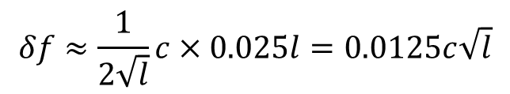
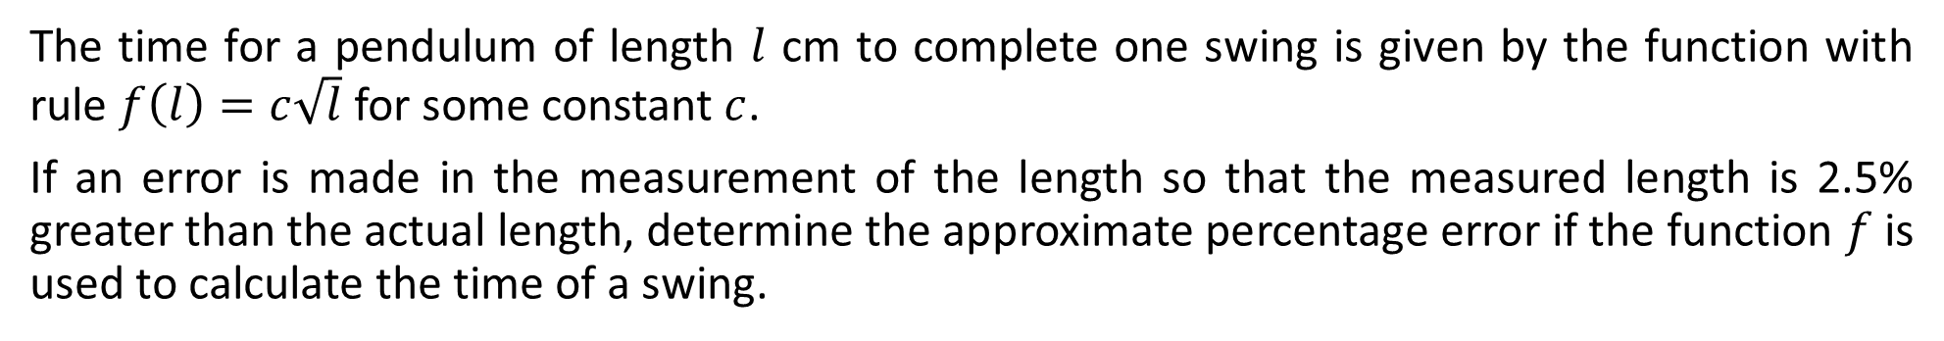
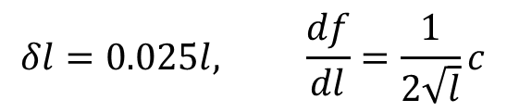

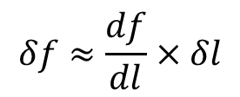
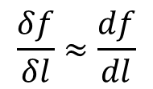
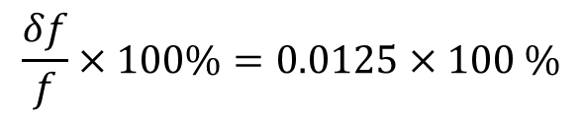
Guided Practice
The time for a pendulum of length $l$ cm to complete one swing is given by the function with rule $f\left(l\right)=c\sqrt{l}$ for some constant $c$.
If an error is made in the measurement of the length so that the measured length is 2.5% greater than the actual length, determine the approximate percentage error if the function $f$ is used to calculate the time of a swing.
Note: $\frac{δl}{l}=0.025$
$$\frac{δf}{δl}≈\frac{df}{dl}$$
$$\frac{δf}{f}=\frac{0.0125c\sqrt{l}}{c\sqrt{l}}$$
$$δf≈\frac{df}{dl}×δl$$
$$\frac{δf}{f}×100\%=0.0125×100 \%$$
$$δl=0.025l, \frac{df}{dl}=\frac{1}{2\sqrt{l}}c$$
$$=1.25\%$$
$$δf≈\frac{1}{2\sqrt{l}}c×0.025l=0.0125c\sqrt{l}$$
The approximate error is $1.25\%$

Slide 12


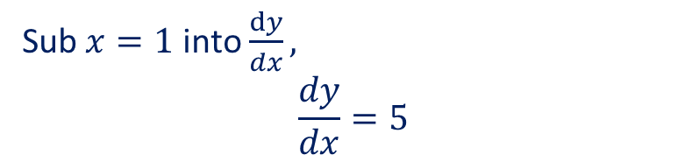


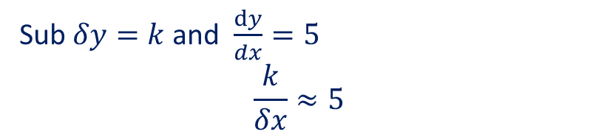


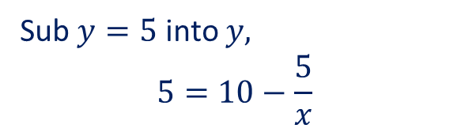

Guided Practice
Given that $y=10−\frac{5}{x}$ and that the value of $y$ increases from 5 by a small amount $k$. Determine the approximate change in $x$ and its corresponding percentage change in $x$
Sub $y=5$ into $y,$
$$5=10−\frac{5}{x}$$
Sub $δy=k$ and $\frac{dy}{dx}=5$
$$\frac{k}{δx}≈5$$
$$\frac{5}{x}=5$$
$$∴δx≈\frac{k}{5}$$
$$x=1$$
$$\frac{dy}{dx}=\frac{5}{x^{2}}$$
Percentage change, $\frac{δx}{x}×100 \%$
Sub $x=1$ into $\frac{dy}{dx},$
$$\frac{dy}{dx}=5$$
$$≈\left(\frac{k}{5} ÷1\right)×100 \%$$
$$=20k\%$$
Recall for small increment change,
$$\frac{δy}{δx}≈\frac{dy}{dx}$$

Slide 13

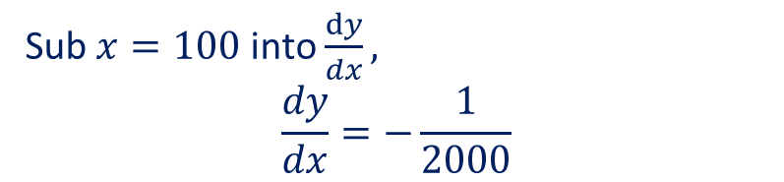

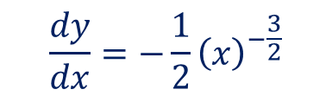


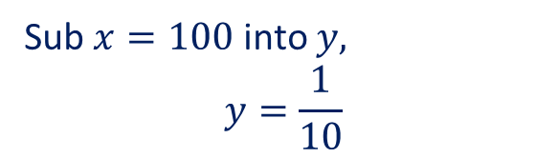

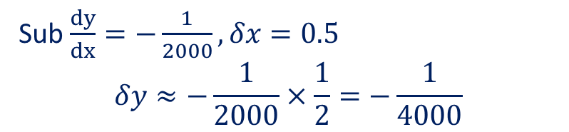
Guided Practice
By differentiating $y=\frac{1}{\sqrt{x}}$ with respect to $x$, determine an approximate value for $\frac{1}{\sqrt{100.5}}$.
Sub $x=100$ into $y,$
$$y=\frac{1}{10}$$
Sub $\frac{dy}{dx}=−\frac{1}{2000}, δx=0.5$
$$δy≈−\frac{1}{2000}×\frac{1}{2}=−\frac{1}{4000}$$
$$\frac{dy}{dx}=−\frac{1}{2}{\left(x\right)}^{−\frac{3}{2}}$$
$$∴y=\frac{1}{\sqrt{100.5}}$$
Sub $x=100$ into $\frac{dy}{dx},$
$$\frac{dy}{dx}=−\frac{1}{2000}$$
$$≈\frac{1}{10}+δy$$
$$=\frac{1}{10}−\frac{1}{4000}$$
Recall for small increment change,
$$\frac{δy}{δx}≈\frac{dy}{dx}$$
$$=\frac{399}{4000}=0.09975$$

Slide 14
Independent Practice
Complete Cambridge Ex 5C exclude Q21 – 23

